Slide 1
Towards The Systematic Design of Model Animation:
Key Ingredients and General Guidelines
Moussa Amrani, Abdelkader Ouared,
Pierre-Yves Schobbens
Modeling Language Engineering (Mle) Workshop
Co-Located with MoDELS 2022
Monday 24th October, Montréal, Canada
Notes:
Hello, everyone. Thanks for coming., my name is ouared abdelkader I’m a post doc researcher from Namur University of Belgium
it my pleasure to be here with you
In this presentation, i will share with you a part of my research intitiled:
Towards The Systematic Design of Model Animation:
Key Ingredients and General Guidelines

Slide 2
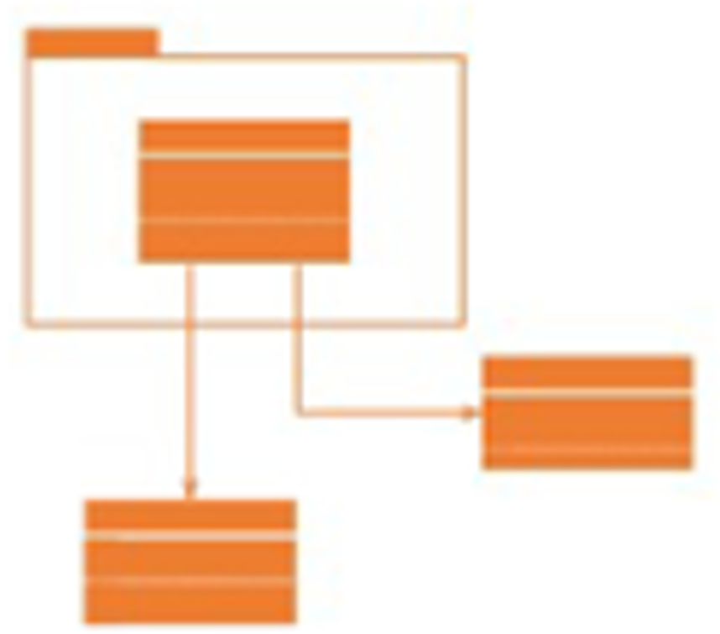



Roles in MDE
1
Metamodel
Transformation Language
Metamodel Level
Language
Designer
Conforms to
Knows
Conforms to
2
3
Transformation Specification
Editor: Model Definition
Model
Level
Palette
class PacMan {
...
def boolean moveR() {
if(self.in.right != null){
self.in = self.in. right
}
}
TS_{VIZ}
Animation
Specification
Transformation Expert
Modeller
Class
Relationship
MA Designer
(new role)
●●●
use
TS_{Xtend}
Application
User
Notes:
As we know in the MDE, we have, at the metamodel level the language designer, who is responsible for design a DSL
At the model level, we have the modeller , his task is to define a model conforms to a metamodel
Tranformation expert actor, his role is to define the language semantic and generate the application of end users
In this study, we introduce a MA designer as new role, to define the animation according to the MT execution,
In MDE we have Actors at different level, at the level of metamodel, we have language designer who is responsible to design a DSML
At the Model level, we found modeller, his task is to define a model that must be conform to MM
The third actor is transformation expert, his role is to define the language semantic and generate the application of end users
Here, we need to introduce a MA as new role, to define the animation corresponding to the MT execution,
-------
DSL designer (engineer) define the metamodel and the transformation for the execution metamodel
Transformation designer : define the transformation pour autre choses comme le test , la verification, la validation, etc.
Animation: relier l’execution de l’animation avec la transformation
Toutes les variables sont discretes, le temps est descret

Slide 3
Roles in MDE
1
Metamodel Level
Domain-Specific Metamodeling Language
Transformation Language
Language
Designer
Knows
Conforms to
Conforms to
2
3
Model
Level
Model Definition
Transformation Specification
Animation
Specification
Modeller
Transformation Expert
MA Designer
(new role)
Application
User
Notes:
As we know in the MDE, we have, at the metamodel level the language designer, who is responsible for design a DSL
At the model level, we have the modeller , his task is to define a model conforms to a metamodel
Tranformation expert actor, his role is to define the language semantic and generate the application of end users
In this study, we introduce a MA designer as new role, to define the animation according to the MT execution,
In MDE we have Actors at different level, at the level of metamodel, we have language designer who is responsible to design a DSML
At the Model level, we found modeller, his task is to define a model that must be conform to MM
The third actor is transformation expert, his role is to define the language semantic and generate the application of end users
Here, we need to introduce a MA as new role, to define the animation corresponding to the MT execution,

Slide 4
Designing Pacman DSL: Metamodel
Game
1 game
AS abstract syntax
AD execution metamodel
score: Integer
* levels
merge
Level
1
1
id: Integer
* personas
1
maze
1
maze
imports
Maze
Persona
operational semantics
0..1
in
* cookies
1..* cells
id: Integer
Cookie
0..1
left
Cell
0..1
right
PacMan
Ghost
1 on
down
0..1
up
0..1
MM_{PM}
Object Management Group. OMG Unified Modeling Language (OMG UML), V 2.5, September 2013. http://www.omg.org/spec/UML/2.5.
Notes:
More precisely, we consider the model state to be defined in an execution metamodel that extends the abstract syntax metamodel using a non-intrusive extension mechanism, such as package merge [Obj13a]

Slide 5


Designing Pacman DSL: Model
< game : Game |
score = 0; level = [ unique : Level];
personas = [ pacman, ghost] >
< unique : Level | maze = maze >
< maze : Maze | cells = [tl, tr, bl, br] >
< tl : Cell | right = tr; down = bl >
< tr : Cell | left = tl; down = br >
< bl : Cell | up = tl; right = br >
< br : Cell | up = tr; left =bl>
< pacman : PacMan | in : tl >
< ghost : Ghost | in : br >
L
SCORE 0
^{Viz}M_{2x2}
1
tl
right
tr
in
left
MetaModel
up
up
down
down
bl
right
br
^{TXT}M_{2x2}
left
in
game:Game
maze:Maze
cells
cells
Model
score = 0
maze
in
tl:Cell
left
tr:Cell
personas
pacman:PacMan
up
right
up
unique:Level
down
left
down
cells
bl:Cell
right
br:Cell
cells
levels
id = 1
in
M_{2x2}
ghost:Ghost
^{OD}M_{2x2}

Slide 6
Designing Pacman DSL: Transformation
▶
TS_{PM}
AS abstract syntax
AD execution metamodel
merge
class PacMan {
...
def boolean moveR() {
if(self.in.right != null){
self.in = self.in. right
}
}
TS_{VIZ}
imports
operational semantics
1
right
2
1
right
2
in
TS_{Xtend}
in
:PacMan
[isAvailable(self.in.)] moveR
<<delete>>
in
<<create>>
in
AVAILABLE
MOVED
RIGHT
timeout
:Cell
right
:Cell
TS_{GBT}
[not isAvailable(self.in.)] moveR
TS_{GBT}

Slide 7
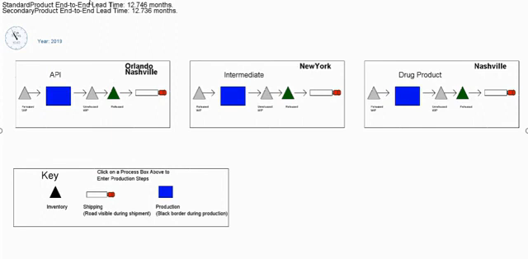
Animating Models
Pacman Model Animation
SCORE 0
^{Viz}M_{2x2}
Supply Chain Model Animation**
in
tl
right
tr
left
in
up
up
down
down
bl
right
br
left
in
FSM Model Animation
abc
2
a
b
a
b
a
3
**https://www.youtube.com/watch?v=GVJO2PuJD6w&t=2s

Slide 8
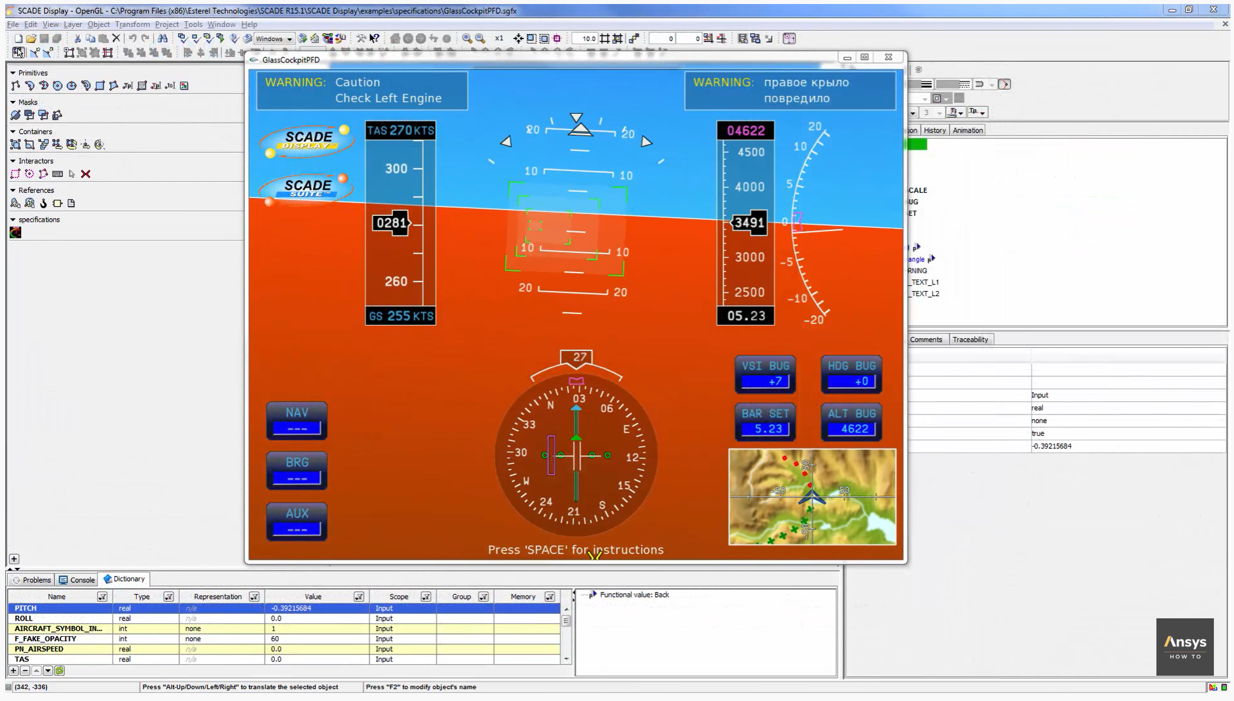



What we don’t address
https://www.youtube.com/watch?v=kaJfTS2WvEA
Notes:
-Another example of Model Animator, from the community of Modelling & Simulation that based on a dedicated modeling language such as modelica langauee, SCADA. System -This figure illustrates a Model animator as dashboard that captures using sensors in real time the atmospheric properties like temperature , and wind speed
-However, In our research we don't address this kind of simulation and animation challenges, because its complexity and the requirement related to strict time constraints. ------------------
-This figure illustrates a Model animator that is a dashboard embedded in the windshield car vehicle.
-During driving the atmospheric properties like temperature, humidity and wind speed are captured in real time using sensors
-In our research we don't address this kind of simulation and animation challenges, because and because its complexity and the strict time constraints.

Slide 9

What is a Model Animation ?
Visualization (aka. Rendering)
A rendering transformation assigns one (or more) concrete representation(s) to each abstract syntax element or group of elements in an input model, as long as the meta-model of the concrete syntax is defined explicitly.
Simulation
A simulation transformation defines the operational semantics of a modeling language that updates the modeled system’s states.
Inplace & Endogenous
Animation
Animation is the visualization of a simulation
p1:Pacman
in
C1: CELL
id = 1
MovePacman
1
right
2
1
right
2
in
in
CS
Rendering
MM
Parsing
Simulation
M_{CS}
M
Animation
Simulation
[1] Lúcio, Levi and Amrani, Moussa and Dingel, Juergen and Lambers, Leen and Salay, Rick and Selim, Gehan M. and Syriani, Eugene and Wimmer, Manuel. (2014). Model Transformation Intents and Their Properties. SoSyM 15(3), 647--684
Notes:
So what is a Model Animation:
By eexploring the litterature, we realized the presence of confusion in literature between the concepts of visualization, simulation and animation:
To clarify,
first, the visualization: is a rendering transformation assigns one (or more) concrete representation(s) to each abstract syntax element or group of elements in an input model
For example: mapping the pacman icon to the Object class pacman
The simulation: A simulation transformation defines the operational semantics of a modeling language that updates the modeled system’s states, that inplace and Endogenous
for exemple the rules movepacman , update the state model by chainging the pacman position
The Animation: is the visualization of a simulation, so we need to perseive the execution steps and the model state of simulation execution and provides its corresponding animation using a given CS

Slide 10

Decoupling TUs and AUs
Decoupling
TU
0..*
0..*
AU
TU
AU
Flexibility of MA
AU₁
Sequential Concurrent
Fire
Fire
AU₂
●● ●
AU_{n}
Reuse of MA
TU_{FSM}
AU_{i}
MovePacman
TU_{PM}
tl
right
tr
in
left
Notes:
- In order to ensure this coordination between animation and transformation, we decide decoupling TUs and AUs.
- MT is decomposed into smaller TU and the animations that are accessed by the TU are represented in the respective unit.
So this mapping concept between animation and transformation will be used different scenarios one to one, one to many or many to many , in order to to achieve more flexibility in MA animation and Enable the reuse of AUs
- In the first scenario of mapping, we attach one AU to one AU . This means that that a single UT to be visualized in multiple MA ( flexibility concept)
-Second, we attach many more granular sets of AUs with one TU.
- And we can reuse AU for several TU of different DSL.
-------------------------
- To achieve more flexibility in MA animation and Enable the reuse of AUs , the concept of mapping will be used different mapping scenarios: 1-to-1, N-to-1, 1-to-N, N-to-M for relating Each the TUs and the AUs
- In the first scenario of mapping, we attach one AU to one AU . This means that that a single UT to be visualized in multiple MA ( flexibility concept)
-Second, we attach many more granular sets of AUs with one TU.
- And we can reuse AU for several TU of different DSL.
--------------------
Si j’ai une règle de réécriture
Si quelque il veut définir une animation
En règles générale une animation correspond à une transformation
On veut relaxer ce truc -> decoupling AU from TU
1: flexibility definition of MA
2: Reuse of MA
Je mappe place a celle et tocken a pacman
On obtient l’animation move pacman
-
-

Slide 11
3 Key Challenges
Explicitly define CS for easily expressing MA;
Build an MA language to express AU in a compositional way,
Explicitly relate MA units with their transformation counterparts
Notes:
- Following our vision to provide a Reusable and flexible components for designing MA Tools (Enable the reuse of AUs For different DSL)
- - Following our vision to provide a Reusable and flexible components for designing MA , We have identified three Key Challenges :
Explicitly define CS for easily expressing MA;
Build an MA language to express AU in a compositional way,
Explicitly relate MA units with their transformation counterparts
-----------------
- Three Key Challenges must be discussed:
Explicitly define CS for easily expressing MA;
Build an MA language to express AU in a compositional way,
Explicitly relate MA units with their transformation counterparts

Slide 12
(Visual!) Concret Syntax
Notes:
First challenge: Concrete Syntax

Slide 13
Complex Rendering Patterns
Rendering
Visual Representation
Final
State
State
...
Initial
Initial
Regular
Regular State
Final
Initial State
Regular
Final State
Transition
Transition
Notes:
To Explicitly define CS for expressing MA; we need a Complex Rendering Patterns
To explain the challenges related to a complex rendering patterns,
let’s consider the following example that illustrate the CS of Finite -state machine , here we have the visual representation of FSM metamodel (Kind state : symbol for Regular, INITIAL and FINAL states and transition)
We can consider three Usages
- The metamodel element can be mapped by visual element of concrete syntax
- For instance the state of FSM metamodel can be represent by a class State that is a generalization of three class initial, final and regular
- So, to visualize this model, we associate for each class the corresponding visual element of the CS

Slide 14
Complex Rendering Patterns
Visual Representation
Final
State
State
...
Initial
Rendering
Regular
Regular State
self.kind == INITIAL
FSM
1 fsm
Initial State
...
1..*
states
« enumeration »
Kind
State
Final State
self.kind == FINAL
INITIAL
REGULAR
FINAL
kind: Kind
Transition
Transition
self.kind == REGULAR
Notes:
In the second scenario, the representation of the rendering function is based on enumerate of these three kind of states,
in this case to visualize the CS , we must write the queries explicitly using query languages (like OCL-style constraint.) to define the rendering function

Slide 15
Complex Rendering Patterns
Visual Representation
Final
State
State
...
Initial
Regular
Regular State
FSM
1 fsm
Initial State
...
1..*
states
Rendering
« enumeration »
Kind
State
Final State
INITIAL
REGULAR
FINAL
kind: Kind
Transition
self == self.fsm.initial
Transition
FSM
1 fsm
...
self == self.fsm.final
1..*
states
State
1 initial
...
1 final
not (... or ...)
Notes:
In the third scenario, the INITIAL, FINAL and REGULAR states are defined based on references.
So the rendering function is defined as set of OCL expression based on references evaluation
So, From this example, one can see from a simple DSL , a multiple rendering scenarios that must be considered
In fact, we need a complex rendering patterns to handle these scenarios,

Slide 16


Integrating “insideness” natively
Transform
Class
Attribute
C
a: attribute
C
a: attribute
+
Transform
t1
Abstract
Persona
in
Cell
t2
Notes:
- Other feature must be considered in rendering function is to Integrating “insideness” natively
- To more understand the problem, consider the scenario of Pacman game when persona Pacman eats ghost
- As we can see, this illusion can be specifies by sequence of animation in sequential and parallel mode
So a complex visual effect, can obtained by Sequences of images chained to provide this illusion
----
J’ai la notion de composition
----------------------------
Au MM, j’ai la notion de composition, graphique a donne ca
Un truc dédié -> natively
-cette notion n’est pas nativement existe (that does not exist natively )
Laisser ca pour l’utilisateur c’est difficile (howver, defining from scratch irs complex task and error prone, so we define a dedicated solution unlock fully th MA designer)
Associer un élément graphique a chaque classe
Truc au milieu -> position

Slide 17
Supporting animations natively
Fast Update of Visual Features
Browsing, customize/extend/modify
e.g., the position, size, color
Conjoined/Nested Element Block
Usability Mechanisms
Using the Graphical Elements
Using Visual Language
e.g. Block Oriented Modeling, Causal Modeling
Visual Editor Workspace
Visual Features
- Position
- size
- color, ..
Graphical Elements
MA Designer
Edit Element
Notes:
- In the Complex Rendering Patterns, we must support animations natively, regarding the high demands of UX design usability,
- This feature means the capabilities to assist designers create a successful animation product by browsing the existing graphical element, enriching, editing and customizing them.
So, we believe that providing a visual language, allows designers to take advantage of flexibility and reusability of its library component.
- A Visual language allows editing of the properties of the selected elements in the canvas and adopting a drug-and-drop style for the animation building
- This make it more an animation design flexible and fully unlock the CM engineering potential.

Slide 18
MA Specification
Notes:
Now, we move to the second challenge : MA Specification

Slide 19

De-/Re-Constructing MA
Initial Model
M₀
TU₁
AU₁
M₁
How to define AU ?
TU₂
AU₂
dependency
AU₃
M₂
AU₄
AU₅
How to coordinate TU<>AU ?
TU₃
AU₆
M₃
AU₇
●● ●
AU₈
●● ●
●● ●
[1] Syriani, Eugene and Vangheluwe, Hans (2010). De-/Re-constructing Model Transformation Languages. In Workshop on Graph Transformation and Visual Modeling Techniques.
DOI: http://dx.doi.org/10.14279/tuj.eceasst.29.407
Notes:
The coordination between Animations and transformation chain, is driven by trigger events, in witch, one step of transformation triggers one or several animation steps,
For instance, we can see from Figure:
The first transformation step corresponds to one AU step
The second and fourth transformation step correspond to 3 steps
And the third correspond to 5 animations steps
The question here, how to orchestrate this execution between the both process ?
----
Trafo is a program to perform coordinate transformations useful in combination with the analysis of single-crystal NMR spectra
--------------------------
Initial model -> truc graphique
Rien ne garantir comment exécuter AU
Comment relier
Comment définir AU

Slide 20
MA Effects
Appearing
● ● ●
APP
ZOOMIN
Disappearing
● ● ●
DAPP
ZOOMOUT
Action
● ● ●
Change Color
Change Style
Notes:
- For MA effect, We have identify atomic and derived AU
- For Atomic MA Effect, we have
- Appearing Effect: like zoomin
- Disappearing Effect: like zoomout
- Action Effect: like change color and style
Other animation like path follow can be derived from combining these primitives

Slide 21
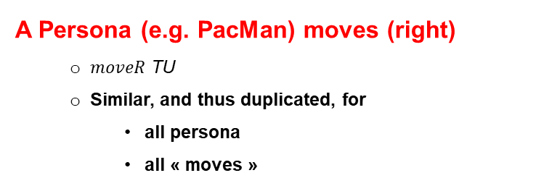
UA Parameterization
A Persona (e.g. PacMan) moves (right)
$moveR$ TU
Similar, and thus duplicated, for
all persona
all « moves »
A Transition is fired, changing the current State
TU fire, defined inside the general transformation accept
SCORE 0
^{Viz}M_{2x2}
abc
tl
right
tr
2
in
left
in
up
up
down
down
3
bl
right
br
a
b
a
b
a
left
in
Define an generic Animation Unit APP-DAPP that
Make a specific element
Disappear from a location, and
Appear into another location
Notes:
- AU can be parametrized to support the reuse aspect.
- Here an example of move Right of Pacman, so the similar AU be duplicated by for all moves, just by parameterize the persona and the direction
- Also the optional parameter of appear or disappear frequency can be used in order to show that the persona follows a specific path between CELLS
- This AU of move right can be reused for other DSL, like fire token, in which Pacman is replaced by token and CELL is replaced by place
So, we must define a generic Animation Unit APP-DAPP that
Make a specific element
Disappear from a location, and
Appear into another location

Slide 22

UA Parameterization
BLINK
DAPP
;
APP
period = period
what
on
what
from
period
what
period
what
where
where
period = 1 second
tl
period = 1 second
tl
Notes:
-So we have two primitives DAPP with two parameters what means the persona and on means the location
- APP with two parameters what and from
-These atomic primitive are composed to build a block of animation that we called BLINK
-So to use this block, a designer just attachs Pacman and CELL and customize the period of composer

Slide 23
UA Parameterization
A Transition is fired, changing the current State
TU fire, defined inside the general transformation accept
DAPP
DAPP
what
on
rendering
what
on
what
where
what
where
t1: Token
s1: State
id = 1
Notes:
- AU can be parametrized to support the reuse aspect.
- Here an example of move Right of Pacman, so the similar AU be duplicated by for all moves, just by parameterize the persona and the direction
- Also the optional parameter of appear or disappear frequency can be used in order to show that the persona follows a specific path between CELLS
- This AU of move right can be reused for other DSL, like fire token, in which Pacman is replaced by token and CELL is replaced by place
So, we must define a generic Animation Unit APP-DAPP that
Make a specific element
Disappear from a location, and
Appear into another location

Slide 24
UA Scheduling
Embedding the scheduling inside the UAs
Define combinators outside of UAs
AU1
POST
PRE
BLINK
;
MOVE
AU2
POST
PRE
●● ●
abc
2
a
b
a
b
a
3
Notes:
For AU Scheduling, we have identify two Theoretical Approaches
- The first the Scheduling is Embedding the scheduling inside the UAs, this means that defined inside each unit animation using pre-condition and post-condition of each unit animation
- The second method is to define combinators of sequential and parallel mode outside of Uas
-------
Now we try to construct this animation ( nous allons essayer de construire cette animation)
Desapear/ appear, deplacer et clignoter

Slide 25
Relating
Notes:
The third challenge is how relating AU and TU

Slide 26
MT < > MA Coordination
Initial Model
M₀
Locate relevent TUs
Annotating TUs, i.e. @Step
Enable Communication
Interactive Exploration Services
TU₁
M₁
@Step
TU₂
AU₂
AU₃
M₂
AU₄
@Step
TU₃
AU₅
M₃
AU₆
AU₇
breakpoint
stepInto
stepOver
●● ●
AU₈
stepOut
play
examine
steps
examine model state
●● ●
●● ●
GeMoC approach for debugging [Erwan B., et al. 2018]
Notes:
Now we need to be able to notify the MA engine that a TU is currently executed, so the MA engine performs the animation.
Two problems here:
1.How do we locate relevant TUs inside the overall transformation?
2.What is the communication process between both engines?
To solve the problem, we have proposed to use the GeMoC approach for debugging:
- Annotations for TU: This is used in a declarative way by the metaprogramming paradigme (e.g., the @Step annotation provided by Kermeta).
- Communication protocol based on Interactive Exploration Services provided by the most debugger of MT engine . This services helps to get the the execution step and the state model before and after execution of unit transformation

Slide 27
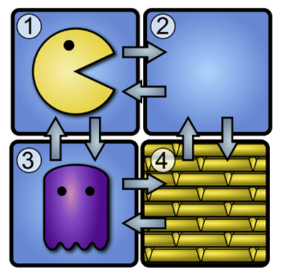
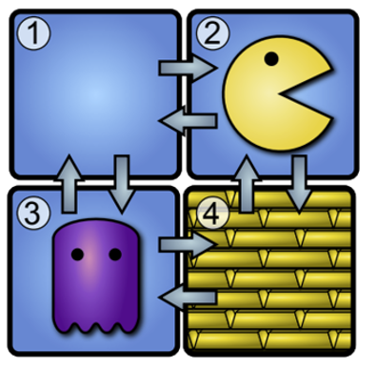
Reusing MA
D_APP
D_APP
DAPP
;
APP
period=_default
DAPP
;
APP
what
from
what
on
what
from
period=_default
what
on
from
to
what
to
what
from
:Token
f:State
t:State
:Token
:Pacman
f:Cell
t:Cell
f:State
t:State
moveR
Notes:
- AU can be parametrized to support the reuse aspect.
- Here an example of move Right of Pacman, so the similar AU be duplicated by for all moves, just by parameterize the persona and the direction
- Also the optional parameter of appear or disappear frequency can be used in order to show that the persona follows a specific path between CELLS
- This AU of move right can be reused for other DSL, like fire token, in which Pacman is replaced by token and CELL is replaced by place
So, we must define a generic Animation Unit APP-DAPP that
Make a specific element
Disappear from a location, and
Appear into another location

Slide 28
Conclusion
TU
0..*
0..*
AU
Key Challenges
Concrete
Syntax
Complex Rendering Patterns
Lack of ﬂexibility in MA
Enable the reuse of AUs
MA
Specification
UA
Composer
UA
DSL Tools to perform MA alongside of MT
MA Designer
MT < > MA
Coordination
class PacMan { ... @Step def boolean moveR() {
MT
MA
@Step
Notes:
At the-end;
-To summarize, I have presented a the Systematic Design of Model Animation as key Ingredients and General Guidelines
-i have noticed that MA designer need a DSL Tools to perform MA alongside of MT
-This because a Lack of ﬂexibility in MA and to enable the reuse of AUs
-Our vision is to the use the concepts of mapping between AU and TU
-Three Challenges have been identified behind this vision
-First, for the concrete syntax the challenge is how to provide a complex rendering patterns to handle the variability specification in AS
-Secondly, MA specification by decoupling : Model Animation Effects, from Model Animation Scheduling
-Finally, the coordination between the both engine is based on annotation and communication
As future work, we are now in the phase of implementing our framework and validation through a case study
—----------------
Tank you for your attentions

